Slide 1
Food and Beverage Management fifth edition
Chapter 5
Food Production

Slide 2
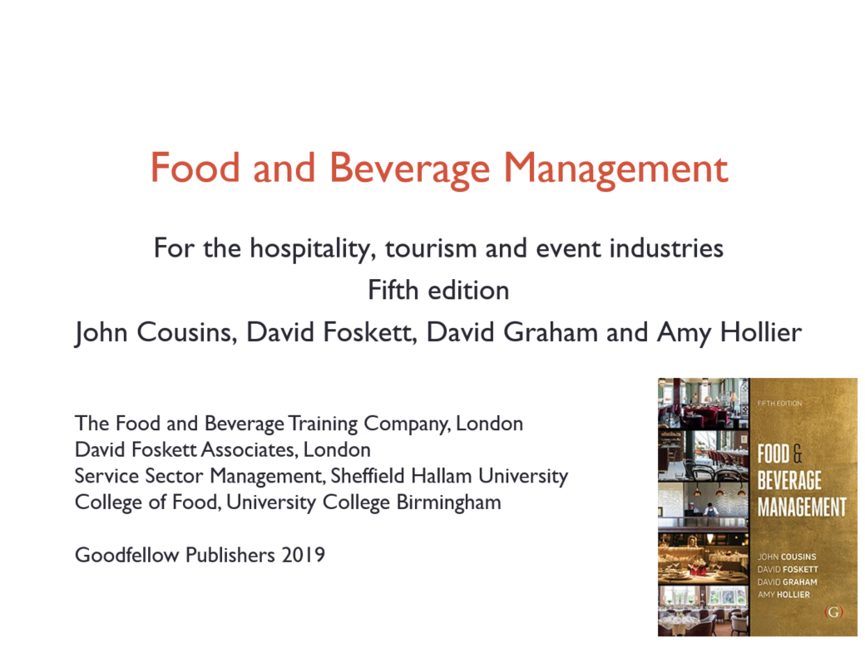

Slide 3
Chapter 5 covers:
Types of menus
Menu planning
Food production systems
Volume in food production
Purchasing
Operational control

Slide 4
Purpose of the menu
Selling aid – method of communication
Adequate information, easily found and followed, will make the customer feel more at home and will assist in selling the menu

Slide 5
Types of menu
All menus, no matter how simple or complex, are based on the two basic menu types:
table d’hôte
à la carte
Some menus offer combinations of these two classes

Slide 6
Other menu terms
Carte du jour (literally card of the day)
Menu of the day
Prix fixe (fixed price)
Tasting menu (‘menu degustation’)
Tasting menus can also be offered with a flight (selection) of wines
For all menus the price of the meal might also include wine or other drinks

Slide 7
Classic menu sequence
Hors-d’oeuvres
Soups (potages)
Egg dishes (oeufs)
Pasta and rice (farineux)
Fish (poisson)
Entrée
Sorbet
Relevé (roasts or other larger joints)
Roast (rôti) (roasted game or poultry)
Vegetables (légumes)
Salad (salade)
Cold buffet (buffet froid)
Cheese (fromage)
Sweets (entremets)
Savoury (savoureux)
Fresh Fruit (dessert)

Slide 8
Most simple menu
Might comprise:
Starters
Main courses
Sides
Afters (cheese/dessert/sweet)
Beverages

Slide 9
Modern menu structures
Classic menu sequence derived from traditional European cuisine and service influences
Menu structure and menu sequences change considerably within the various world cuisines
Menu terms are culturally bound and vary with location

Slide 10
Menu construction
In addition to traditional meal types there are demands for:
Special party or function menus
National or specialty menus
Hospital menus
Menus for people at work
Menus for children
Floor/room service menus
Lounge service menus
Airline tray service menus
Rail service menus

Slide 11
Menu policy
Developed to:
Establish the needs of the customer
Predict what the customer is likely to buy
Determine how much the customer will spend
Ensure efficient purchasing
Effectively control the operation
Ensure a means of communication with customers

Slide 12
Key influences on menus
Gastro-history and gastro-geography
Relationship between health and eating
Dietary requirements
Cultural and religious influences
Vegetarianism
Prominent chefs and media
Trends, fads and fashions
Ethical influences

Slide 13
Local gastronomy a result of:
Gastro-geography - determines how foods and beverages, cooking methods, customs and eating habits are, and have been, influenced by climate, soil, crops, history, tradition, psychology, commerce and the peoples
Gastro-history - determines the influences of the places surrounding a location, and also those beyond, with which the peoples have been, and are, involved

Slide 14
Health and eating
Relationship between health and eating is about having a healthy diet
Individual foods or drinks are not healthier or less healthy
Customers want:
Availability of choices
More specific information on methods of cooking used

Slide 15
Medical dietary requirements
Includes prevention of allergic reactions
Customers need to know about the ingredients
Certain things may cause illness or be fatal
Server must be:
Accurate
Never guess
If in doubt, seek further information

Slide 16
Other dietary requirements
Cultural and religious including:
Hindus; Jews; Muslims; Sikhs; Rastafarians; Roman Catholics
Vegetarianism including:
semi; lacto-ovo; lacto; vegans; fruitarians

Slide 17
Prominent chefs and media
Great influence by prominent chefs
Also from:
Media generally
Social media
Chef, cookery and consumer programmes

Slide 18
Trends, fads and fashions
Trends: developments in technology, cuisine and restaurant styles that lead to long term adoption
Fads and fashions: things that appear, are widely adopted, and just as quickly disappear

Slide 19
Ethical influences
Sustainability of food supply
Fair trade
Acceptability of genetically modified or irradiated foods
Reducing food packaging and food waste
Reducing the effects that food production has on the environment generally

Slide 20
Essential knowledge
Server must know what they are serving
The service requirements
How to advise the customer on:
the content of dishes
the methods used in making the dishes
the accompaniments offered

Slide 21
Developing menus
Essential considerations:
Location and competition
Customer needs and spending power
Number of items and price range of menus
Potential throughput
Space and equipment required
Amount, availability and capability of labour
Supplies and storage
Accuracy of costing
Nutritional information

Slide 22
Menu construction
Daily menus
Pre-planned / pre-designed
Cyclical menus

Slide 23
Menu content and design
Can be presentation in a variety of formats
Need to ensure the look and feel of the menu matches the overall design of the restaurant
And must include:
Clear and accurate descriptions
Clear indication of pricing
Dietary information
Items or groups of items with names customers recognise and understand

Slide 24
Menu layout
Tactics include:
Highlighting customer’s favourites to draw attention to them
Placing more profitable dishes in first and last position on the menu
Keeping prices in the body of the description paragraph
Using illustrations and photos
Responding to eye gaze motion theory
Keeping current by evaluating every six months

Slide 25
Menu copy
Approaches to menu copy include:
Ensuring sufficient description to aid understanding
Ensure right emphasis is given
Culinary terms properly used
Names are those people recognise and understand
Emphasis is maintained by good use of print size and style

Slide 26
Kitchen management
Legacy of Escoffier
Partie system (product based approach)
Standard cuisine terms
Vast development in cooking techniques and equipment
Operations now rationalised and redesigned for efficiency
Alternative process approach (based on production techniques and processes)

Slide 27
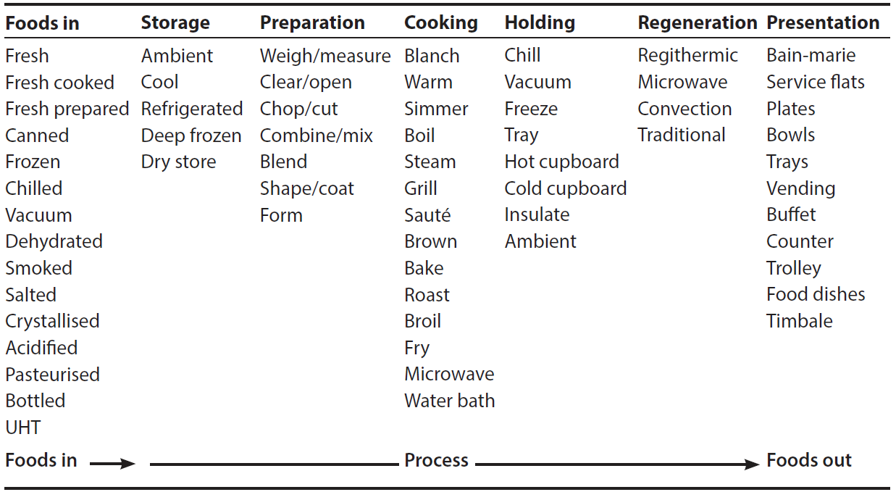
Elements of food production

Slide 28
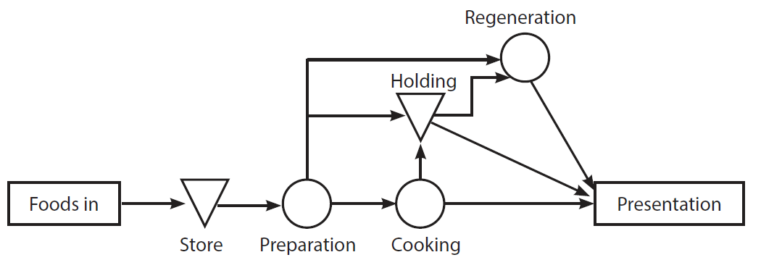
Generic model of food production system

Slide 29
Methods of food production
Conventional
Convenience
Call order
Continuous flow
Centralised
Cook-chill
Cook-freeze
Sous-vide
Assembly kitchen

Slide 30
Volume in food production
Seven stages of the food production process
Foods in
Storage
Preparation
Cooking
Holding
Regeneration
Presentation
Each has an effect on the potential volume of the operation

Slide 31
Purchasing
Six steps for successful purchasing and receiving functions:
Know the market
Determine purchasing needs
Establish and use specifications
Design the purchase procedures
Ensure accurate receiving
Evaluate the purchasing task

Slide 32
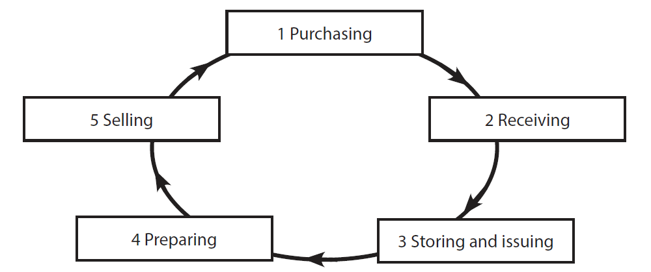
Operational control cycle

Slide 33
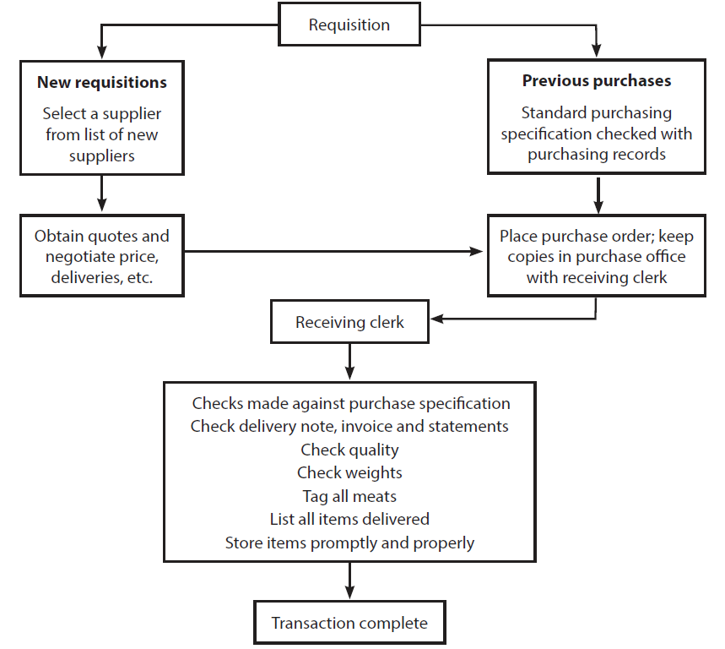
Summary of purchasing transaction

Slide 34
Control and profitability
Summary of the key factors:
Efficient preparation of raw materials
Correct cooking of food to minimise portion loss
Correct portion control
Minimising wastage and reducing theft
Accurate ordering and checking procedures
Reference marks to standardised recipes and yield factors
Sufficient research into suppliers
Accurate forecasting and sound menu planning

